Slide 1
Real Estate Marketplace Wireframes/Mockups
Ridvan Suleymanov, Dio Briggs, Ummey Jahan, Tega Oyibo

Slide 2
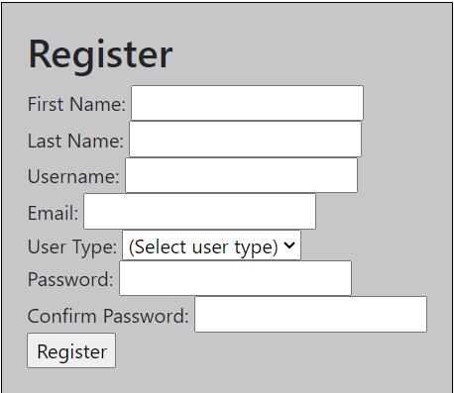
Login

Slide 3
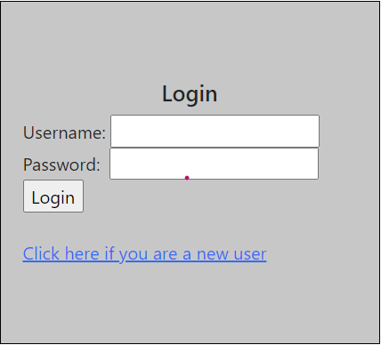
Register

Slide 4

Home
Buy
Sell
Wishlist
Logout
HERE ARE THE PROPERTIES YOU ARE INTERESTED IN…
See Details
Remove from Wishlist
See Details
Remove from Wishlist
See Details
Remove from Wishlist

Slide 5
Home
Buy
Sell
Wishlist
Logout
City, Neighborhood, Zip, Address n
Price
Bed and Baths
Home Type
More
See Details
Add to Wishlist
See Details
Add to Wishlist
See Details
Add to Wishlist
See Details
Add to Wishlist
See Details
Add to Wishlist
See Details
Add to Wishlist

Slide 6
Home
Buy
Sell
Wishlist
Logout
Sell your home today!!!
Enter your address
Enter your City
Enter your State
Enter your Zip Code
Continue

Slide 7

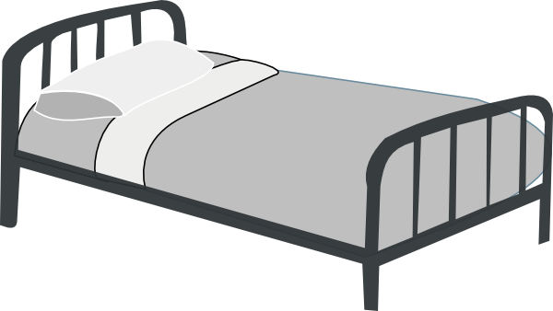
Home
Buy
Sell
Wishlist
Logout
Visuals of property
$300,000
Beds: 3 Baths: 2 Sqft: 1150
865 Sandy Creek DR NW, Atlanta, GA, 30331
Description:
Seller Contact Info:
123-456-7891
seller@gmail.com
Amenities:
Purchase now!!!!!

